Slide 1
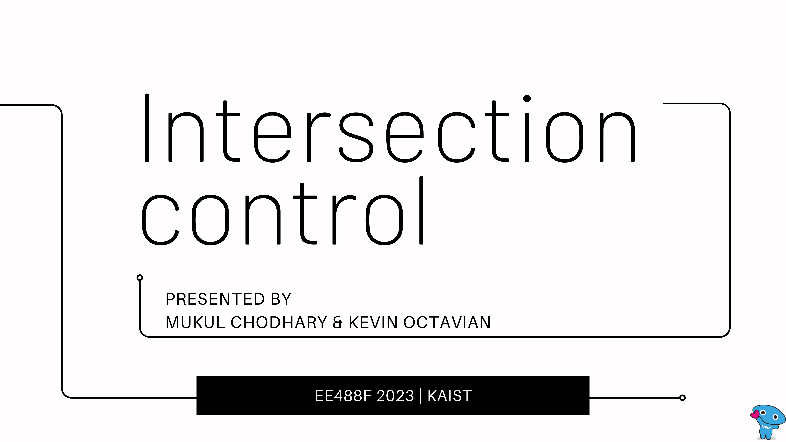

Slide 2
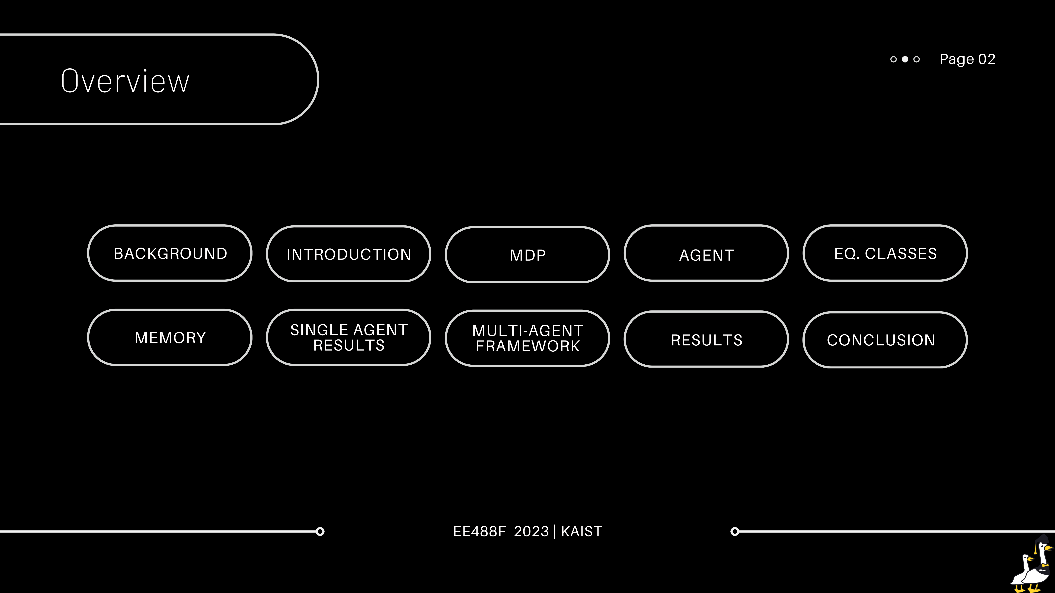

Slide 3
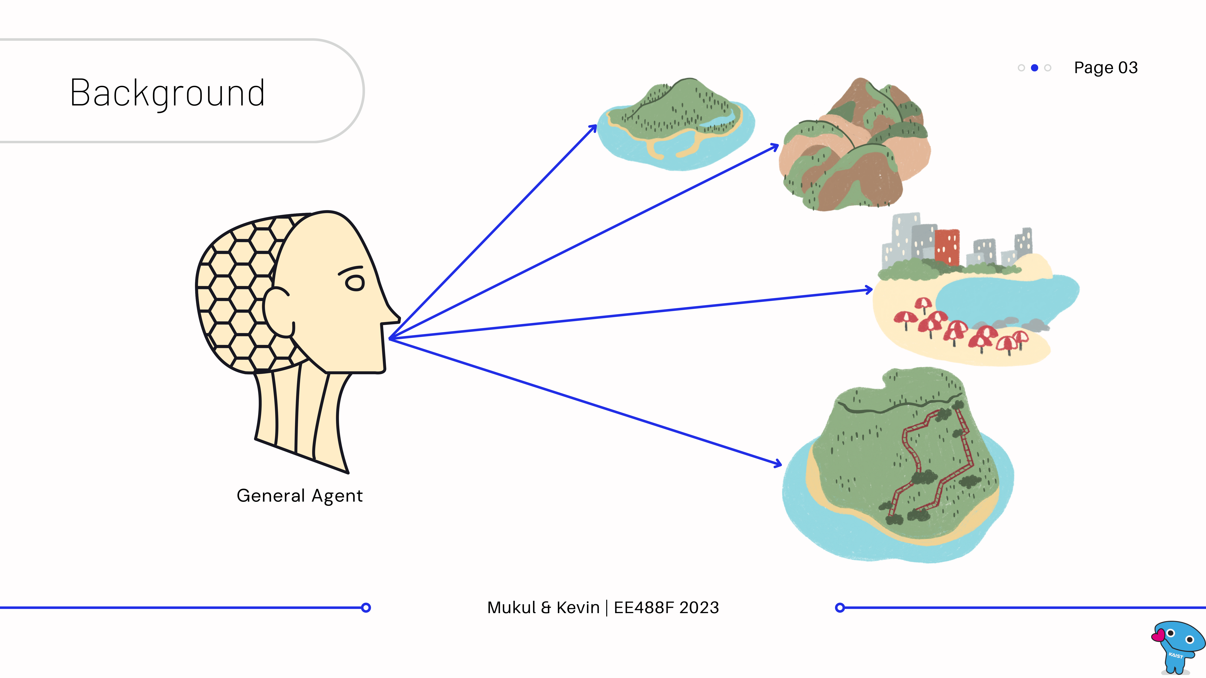
Notes:
When we started the project, our goal was to be able to use Reinforcement learning to create a general agent that is able to perform relatively well over multiple very different environments.

Slide 4
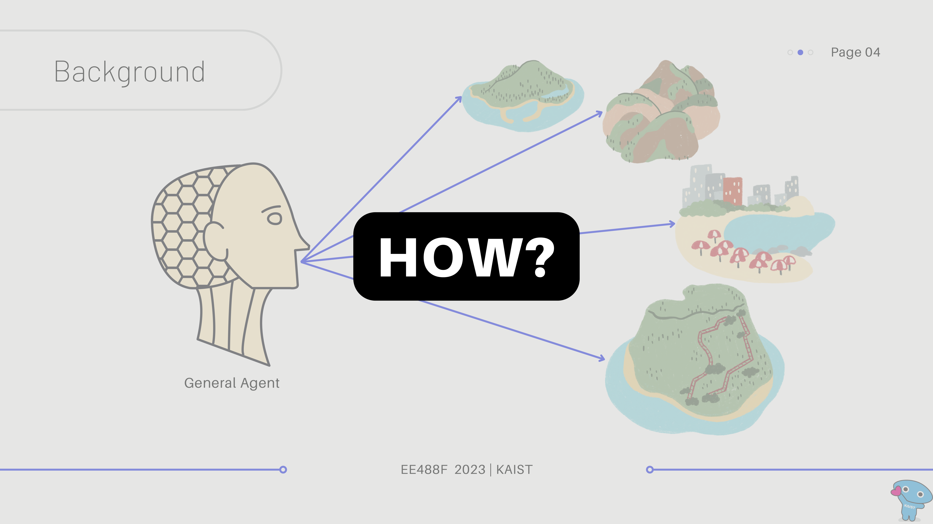
Notes:
You might be wondering how is that possible.
Our quest started with this big goal in our hearts.

Slide 5
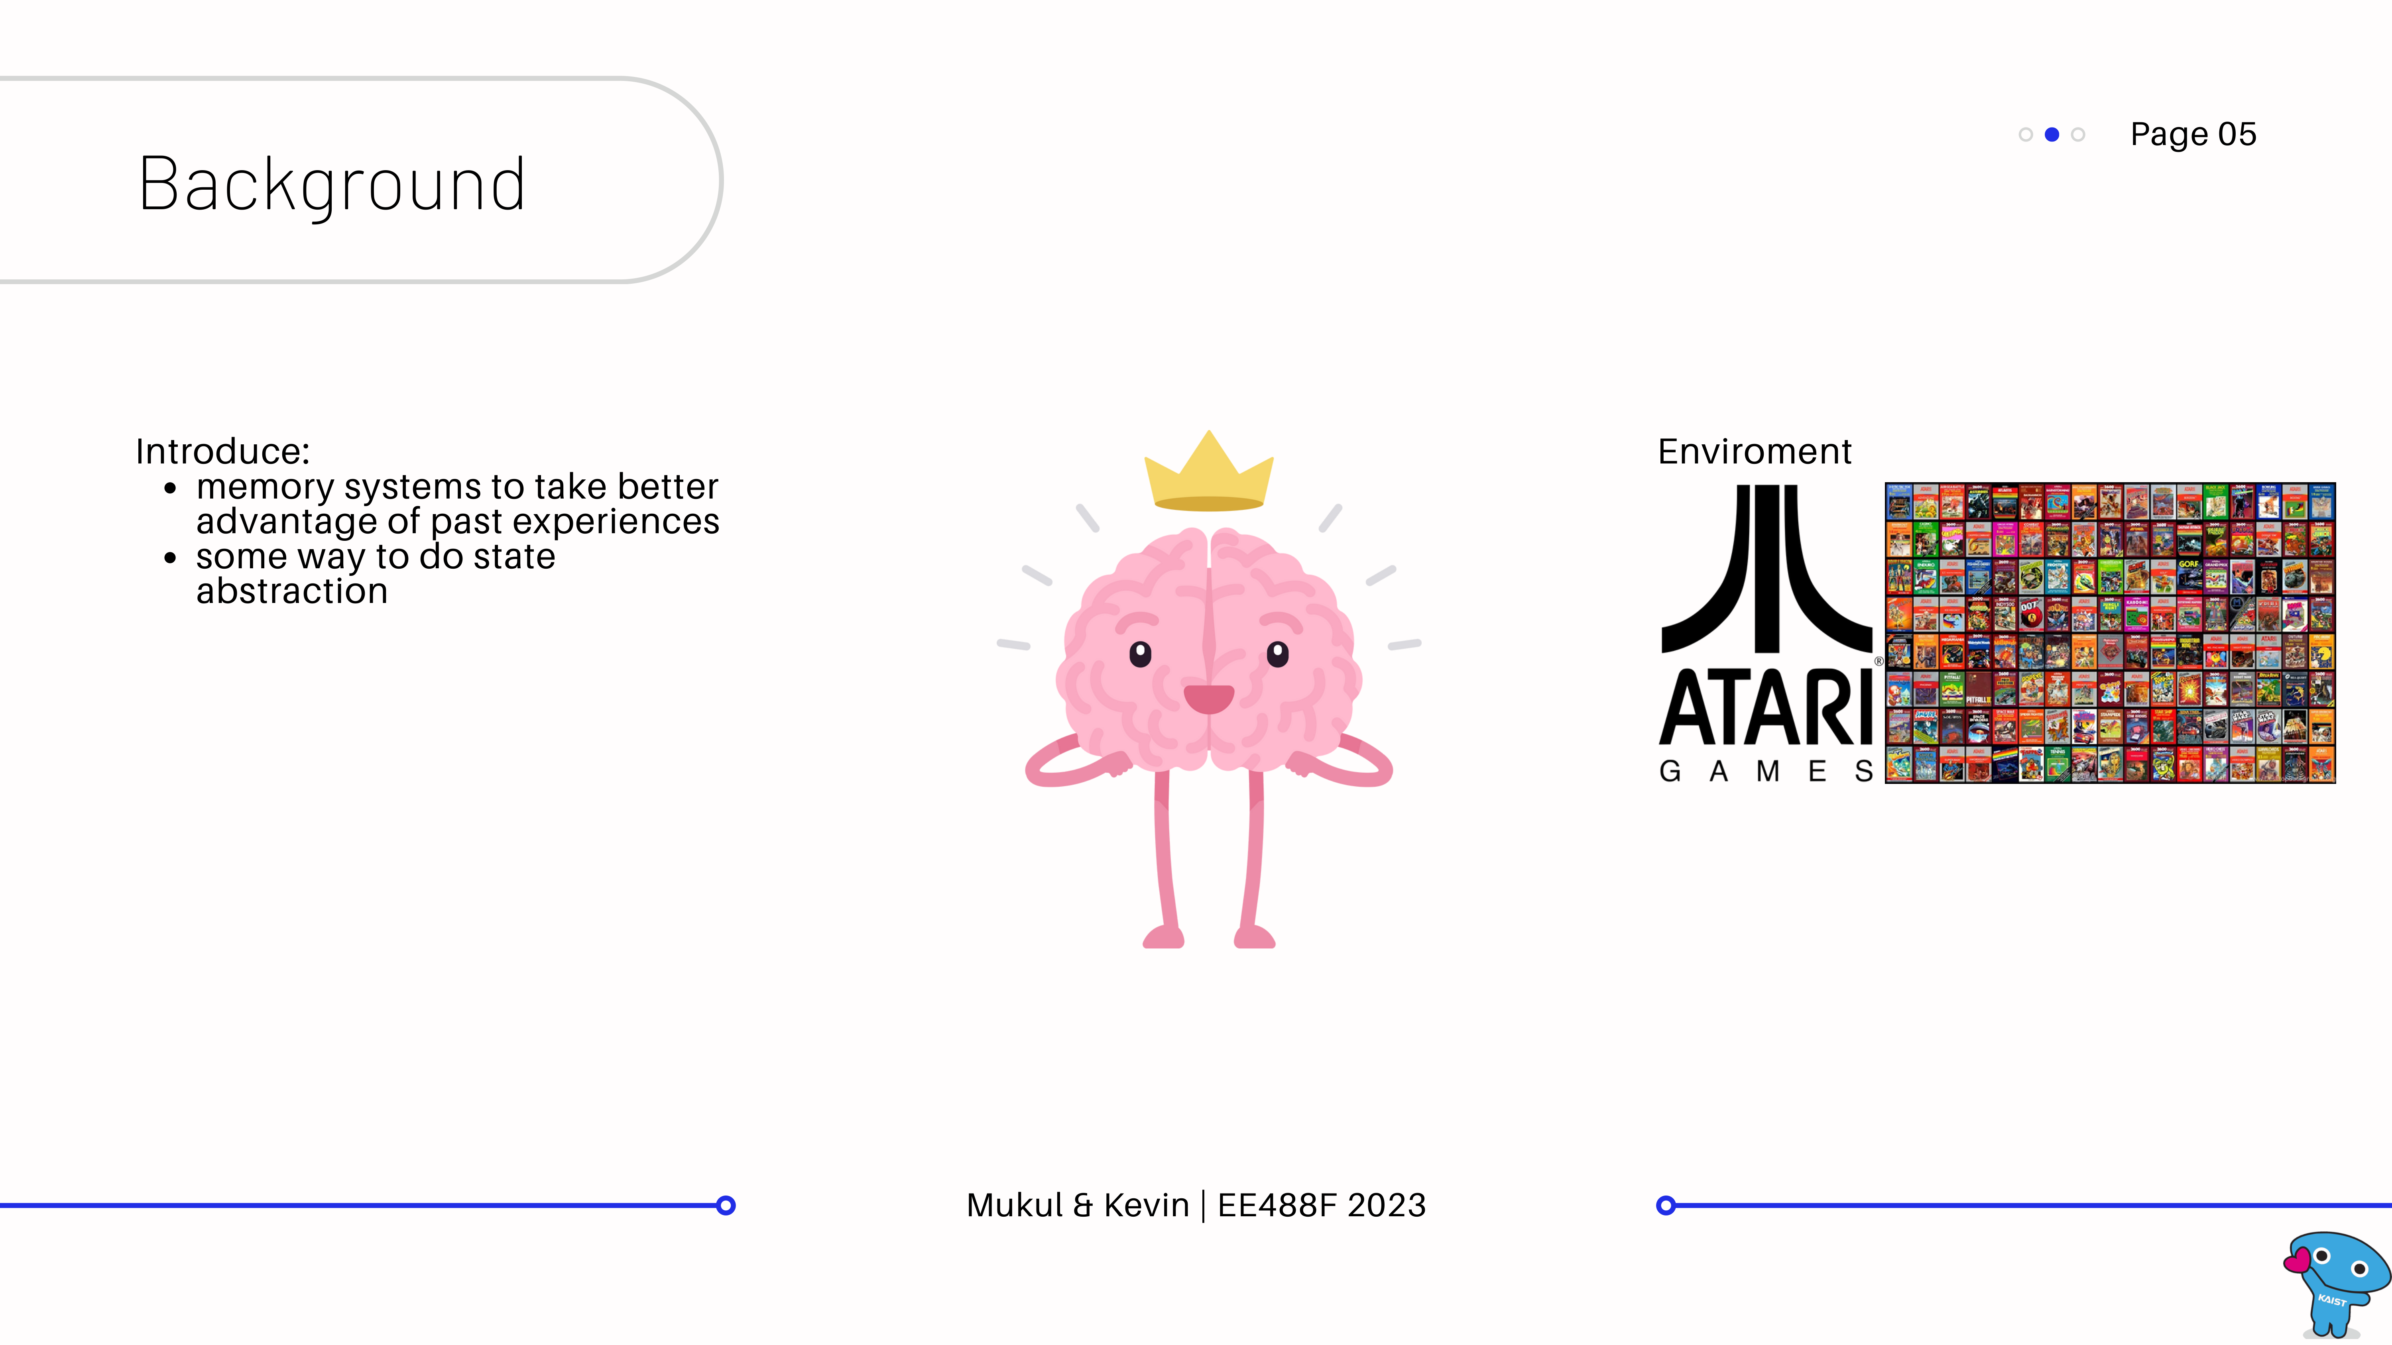
Notes:
Our idea was to incorporate a memory system to record past events that closely mimic the human brain.
We also wanted to add some methods to find similar system states even if they are not exactly the same.

Slide 6
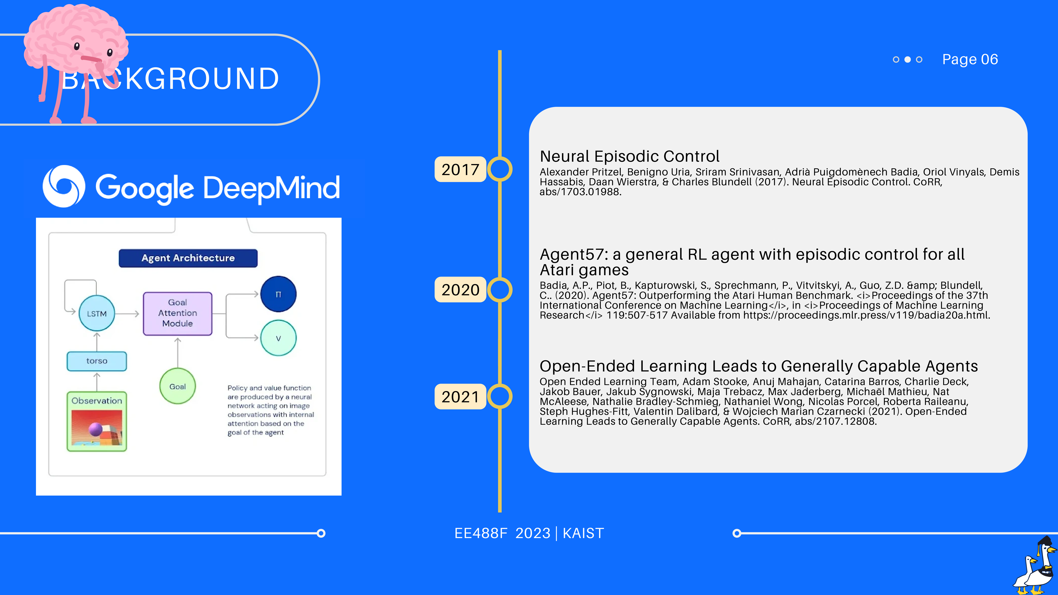
Notes:
During the literature review phase, we quickly found that such implementations have been done after the initial Neural Episodic Control paper by DeepMind.
The Agent57 became the first RL agent that was able to outperform human benchmark performance on all atari games.
In 2021 the DeepMind's open-ended learning team published a paper "Open-Ended Learning Leads to Generally Capable Agents," which outlined steps to train an agent capable of playing many different games without needing human interaction data.
They were able to do it through a procedurally generated vast game environment which they named XLand. This environment includes many multiplayer games within consistent, human-relatable 3D worlds.
We will not go into details of this paper, please give it a read in your time. Also, I am not confident enough to explain that paper here as I am still slowly grasping everything in it.
There is a lot more literature on this topic now, but we just wanted to bring your attention to these three in particular.

Slide 7
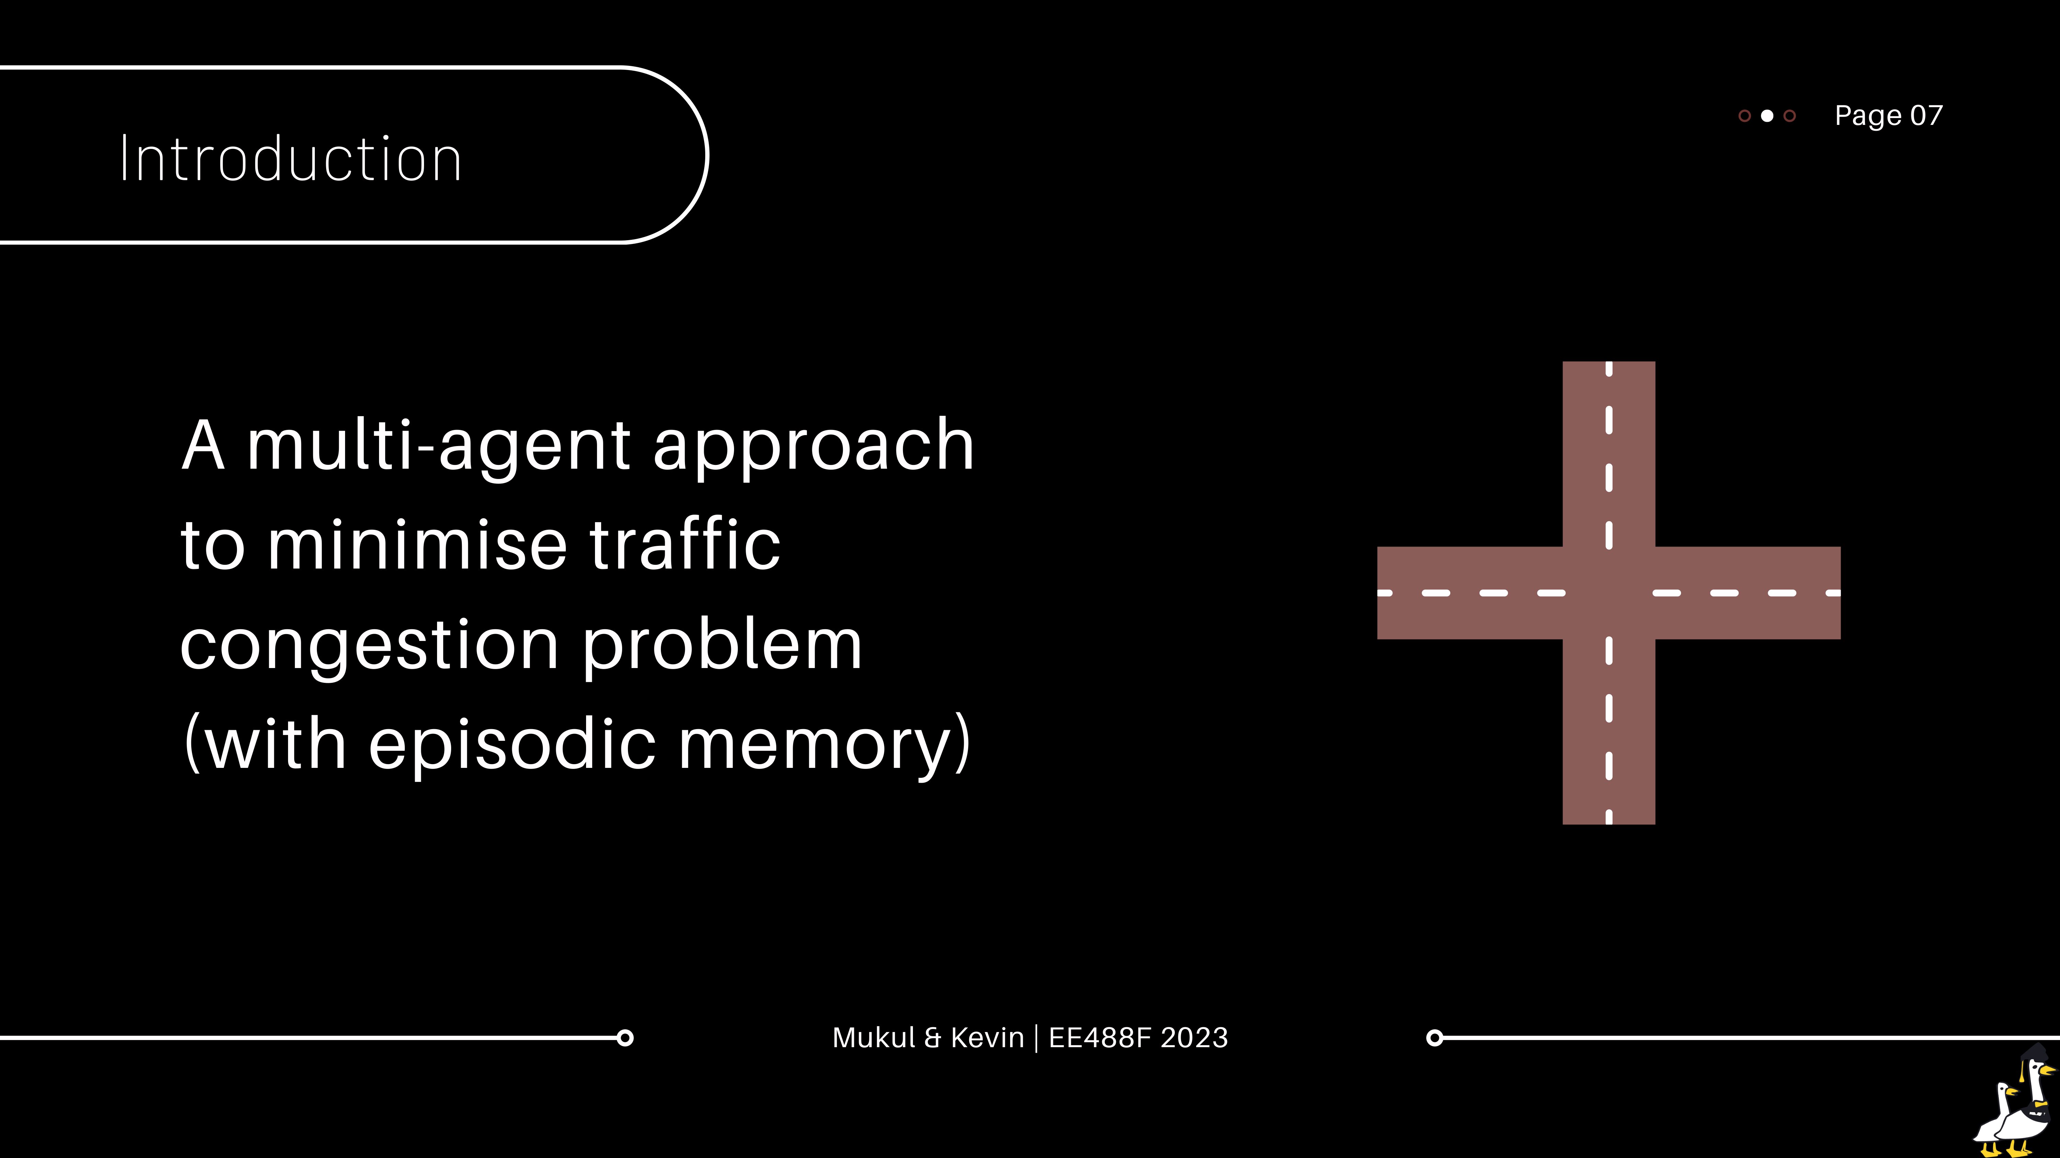
Notes:
With no apparent success in how to continue with ATARI general agent, we decided to pivot to a different application.
We are mainly interested in how using a memory system will enhance the performance, whether it be training speed, size of state-action-reward Q table or desired outcome: lower congestion levels.

Slide 8
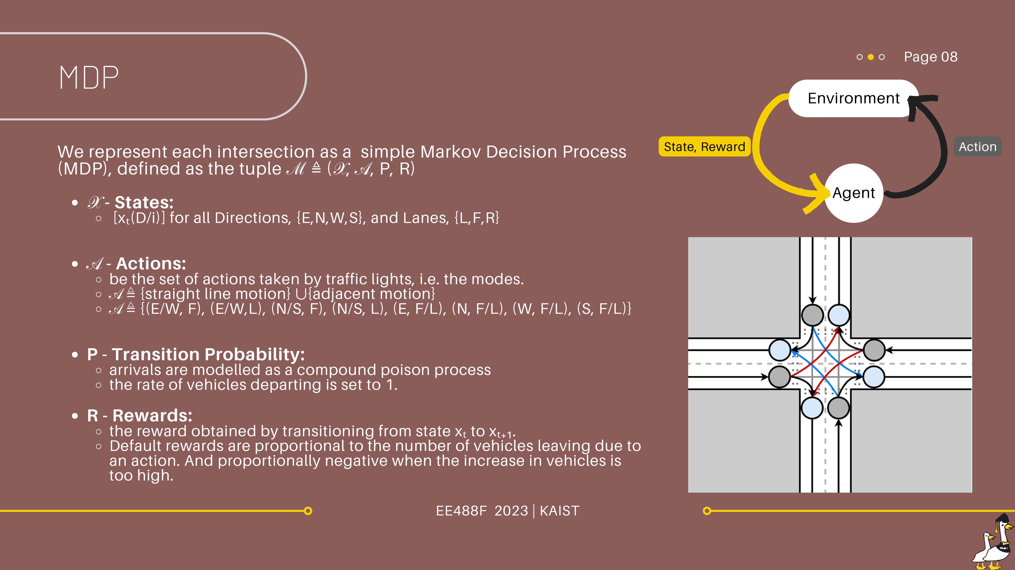
Notes:
Markov discrete process

Slide 9
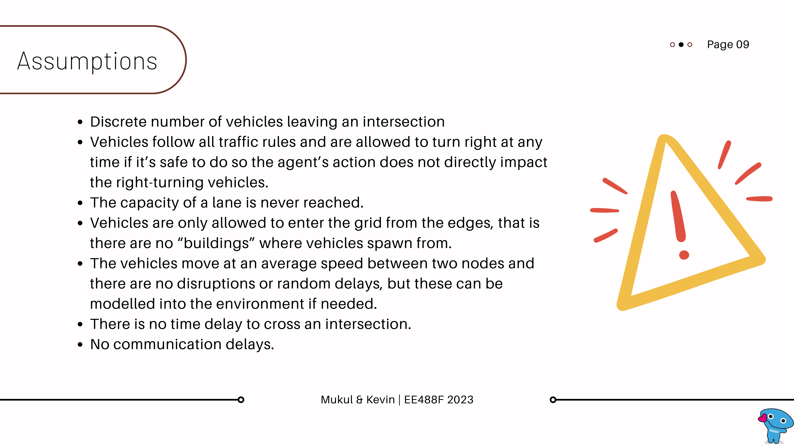

Slide 10
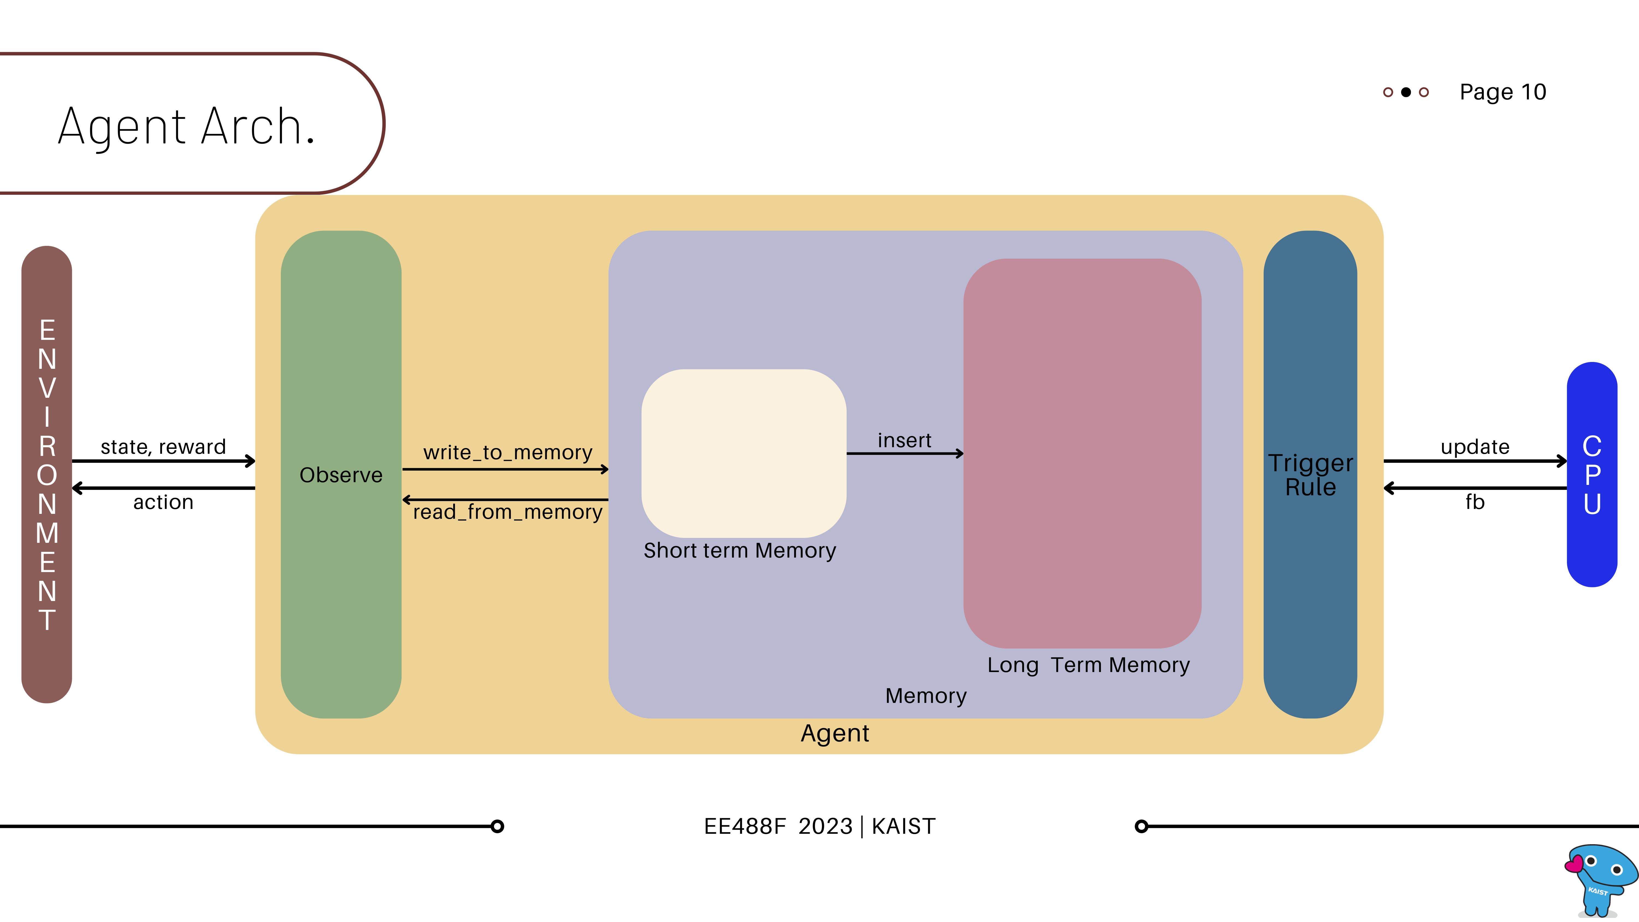

Slide 11
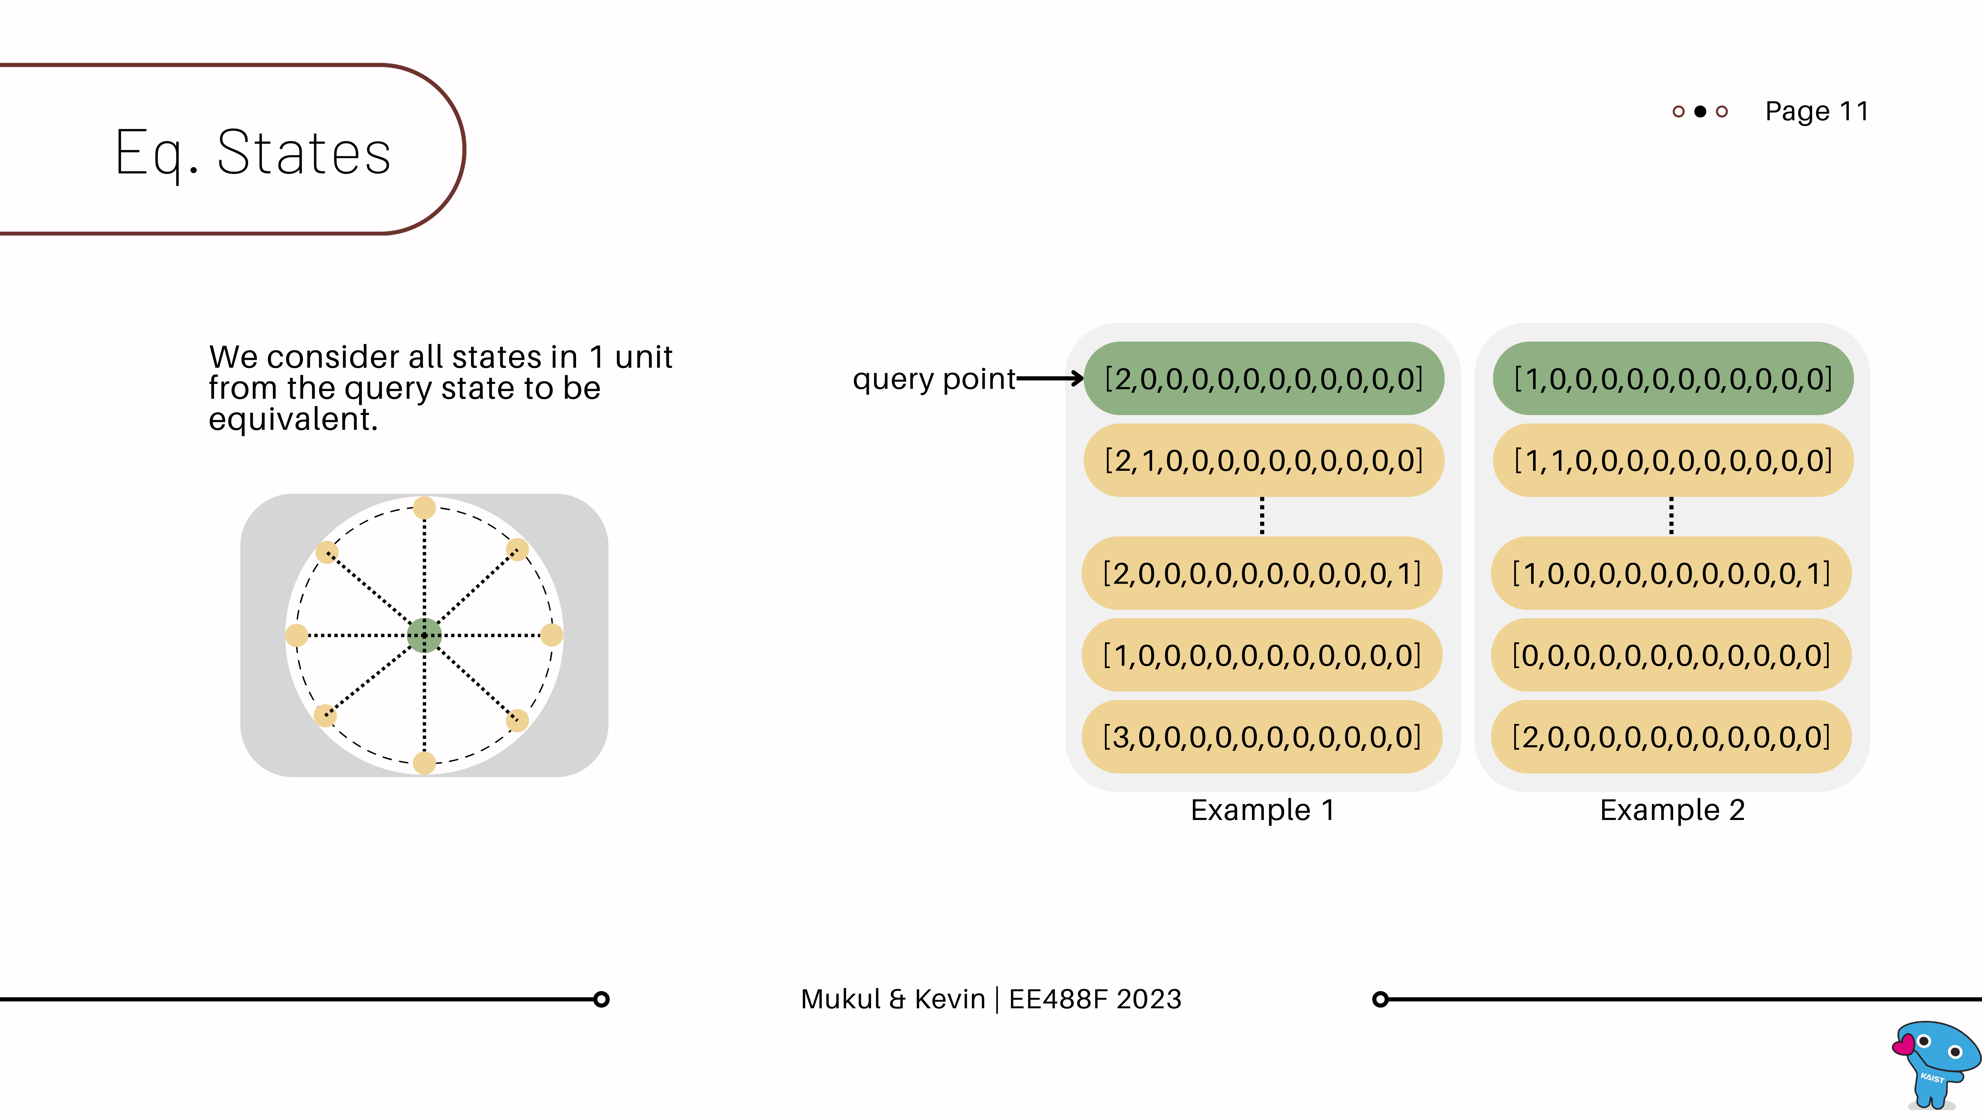
Notes:
We created a simple way to do state abstractions. This is done to reduce the memory size, noting that a more complicated approach can easily be adapted to our current framework.
Our current approach is just to look for states 1 unit away from

Slide 12
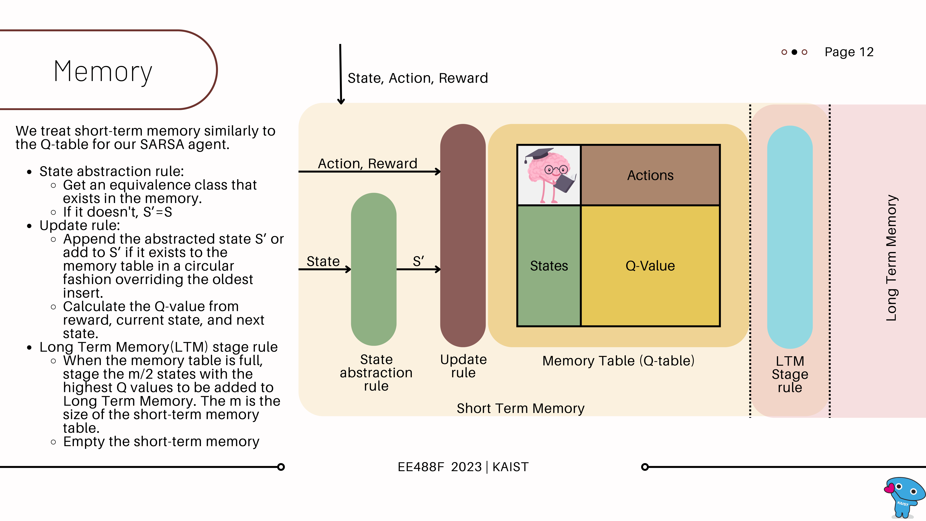

Slide 13
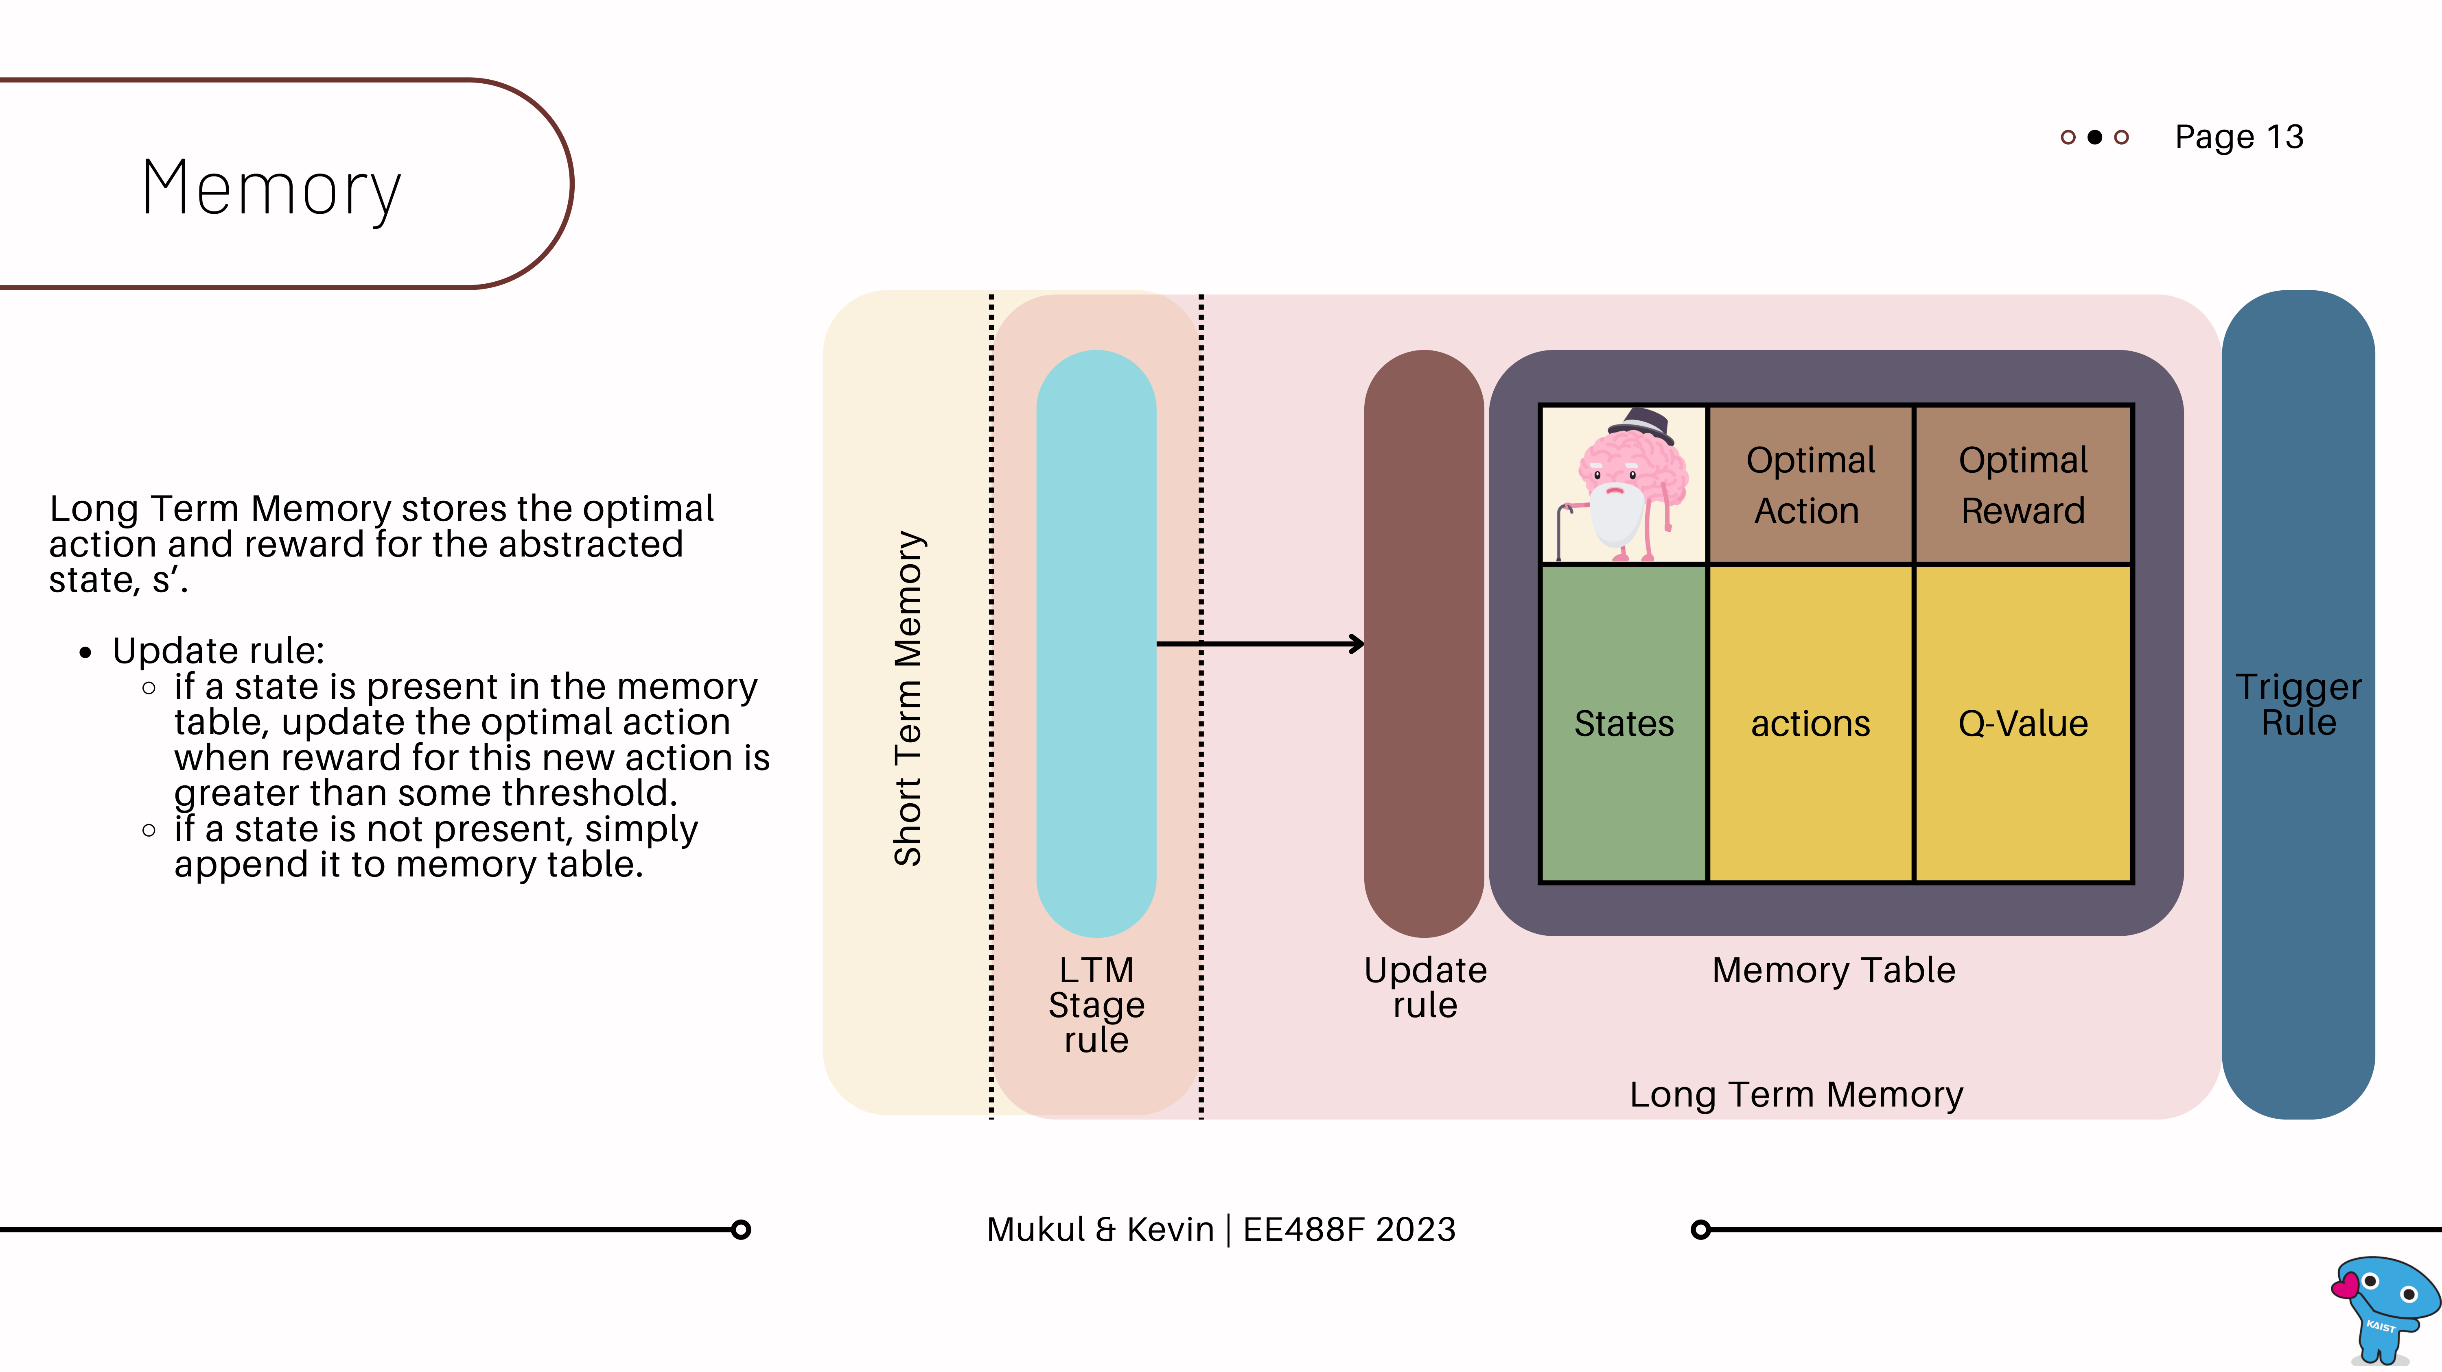

Slide 14
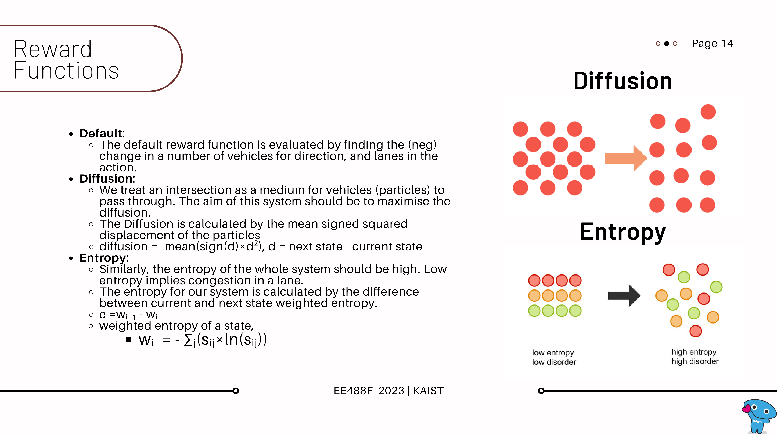

Slide 15
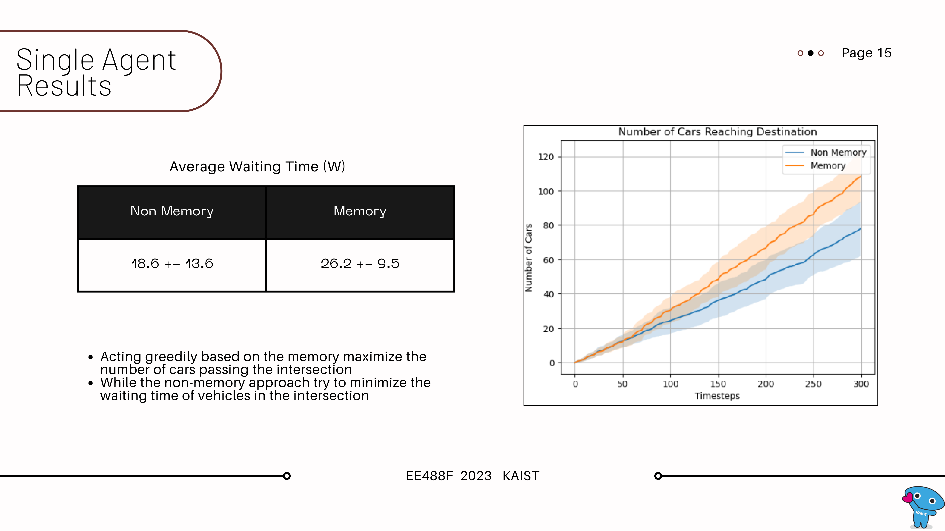

Slide 16
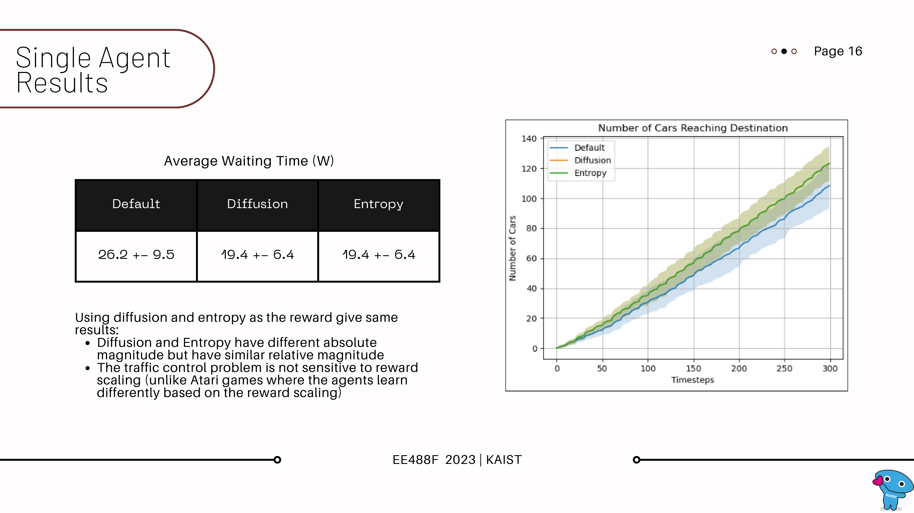

Slide 17
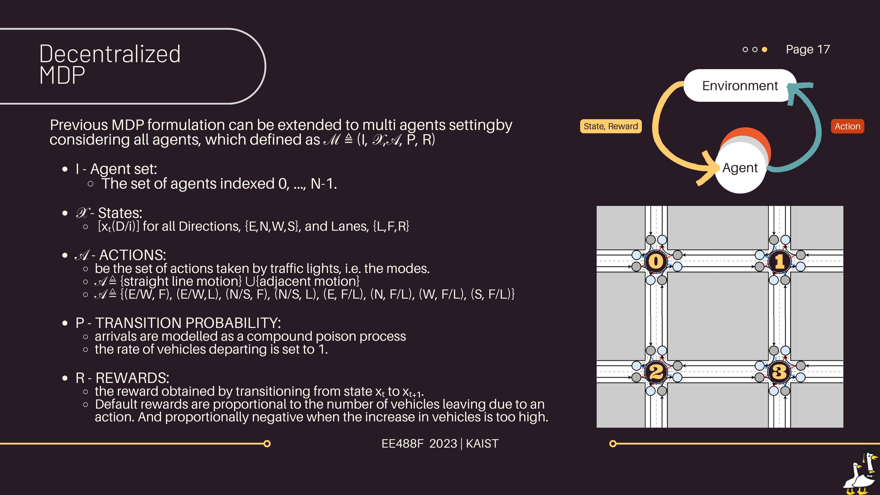

Slide 18
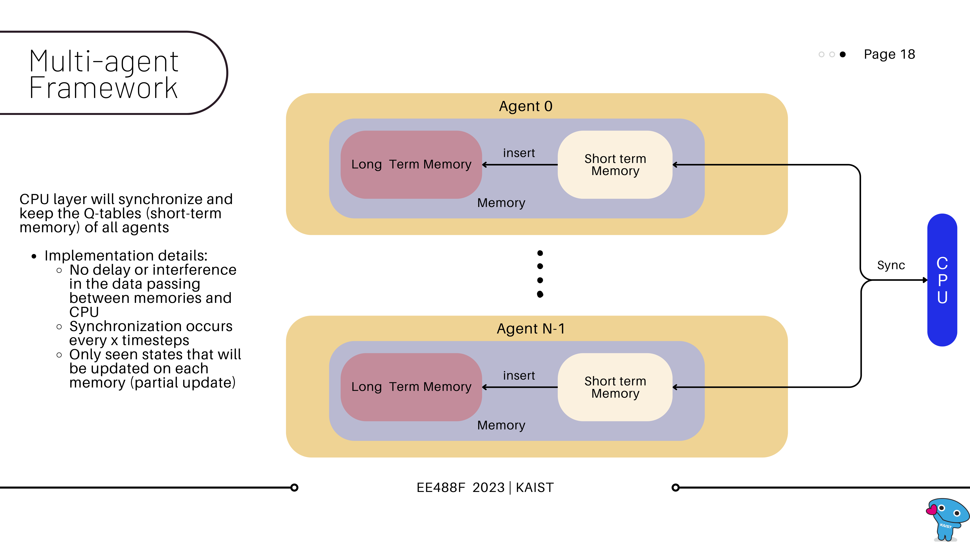

Slide 19
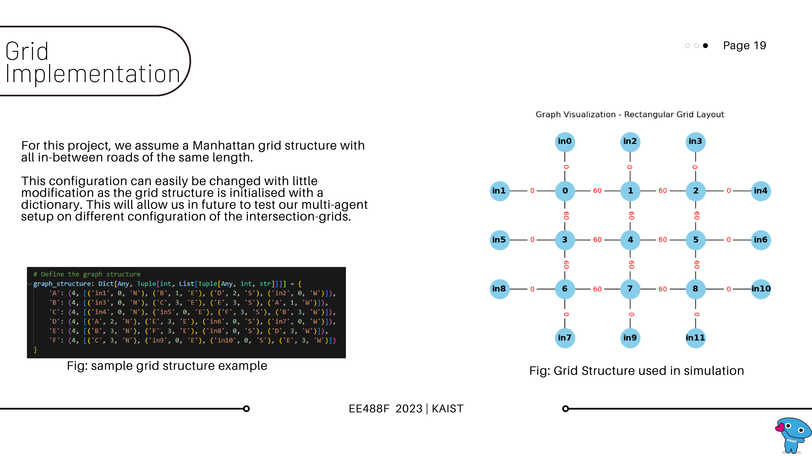

Slide 20
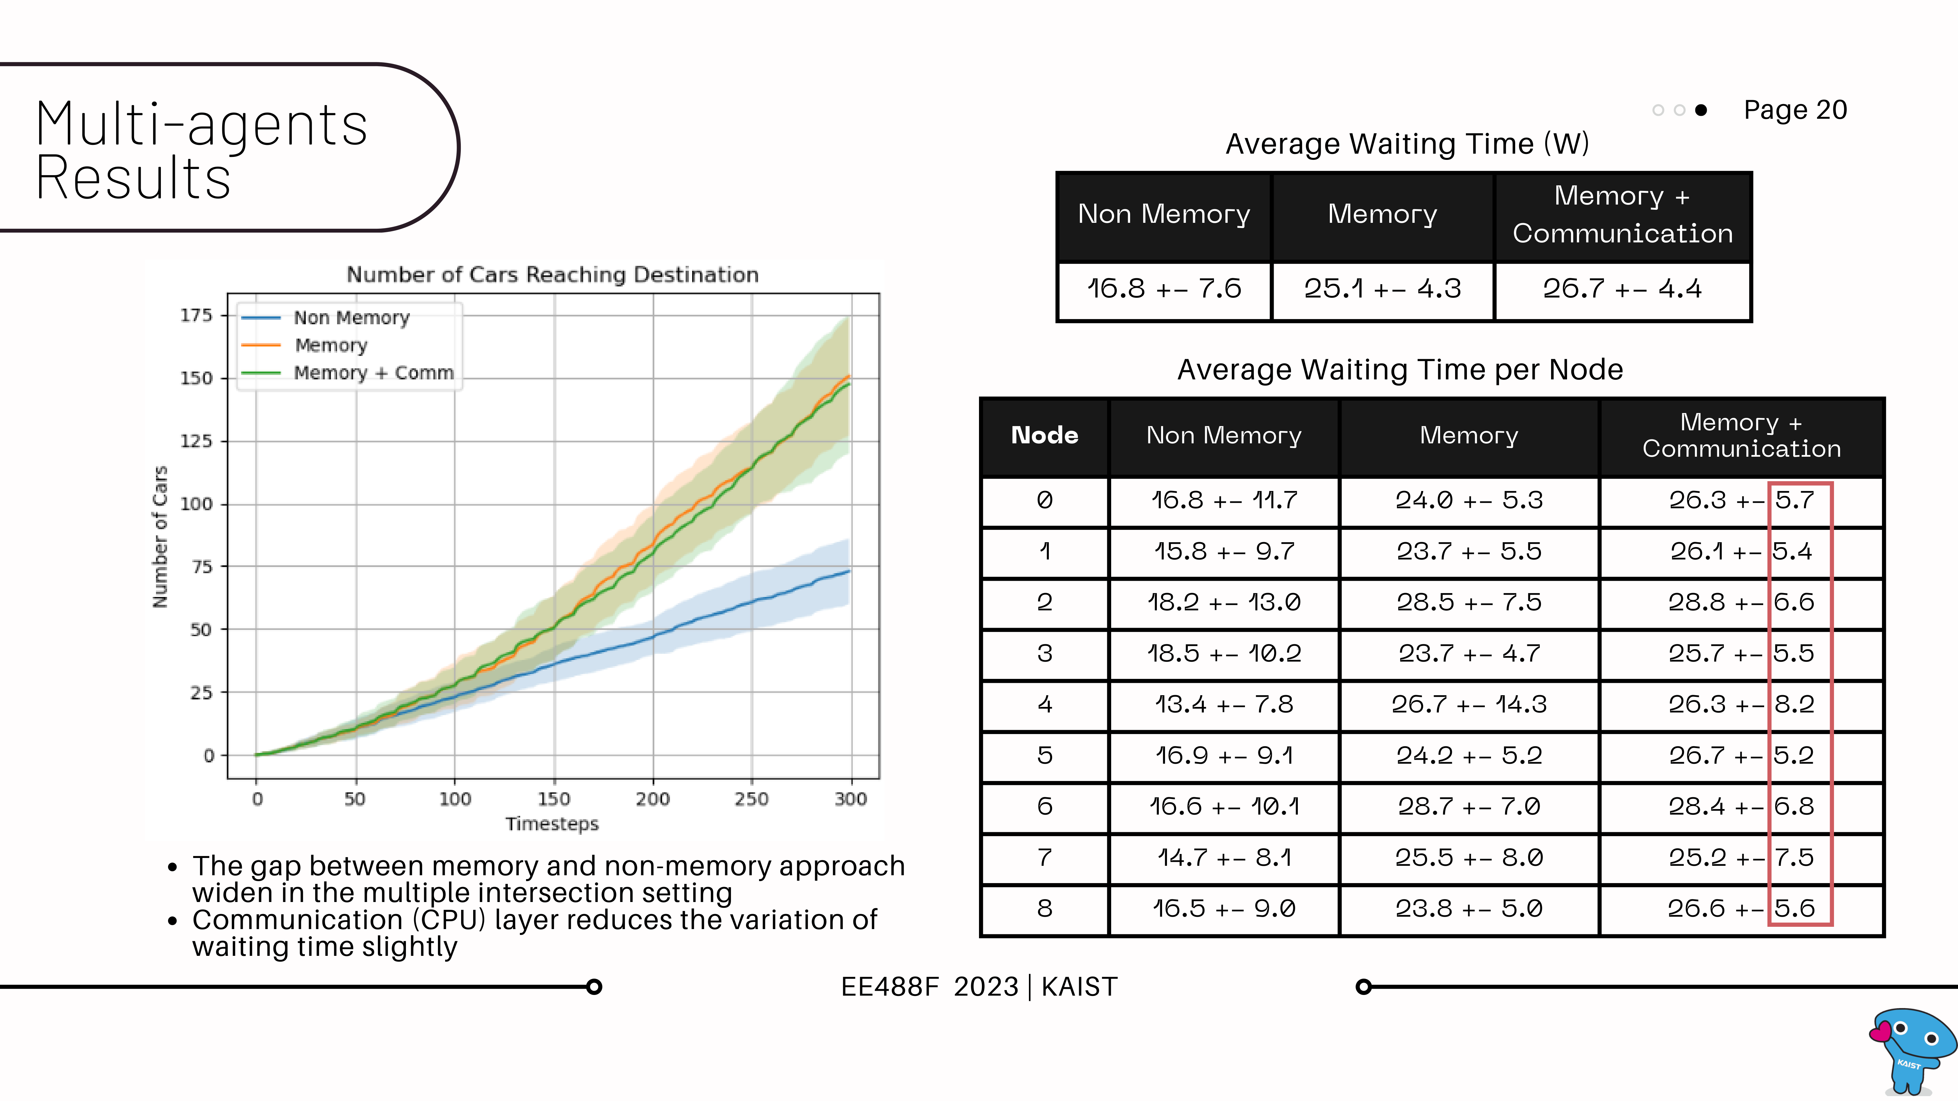

Slide 21
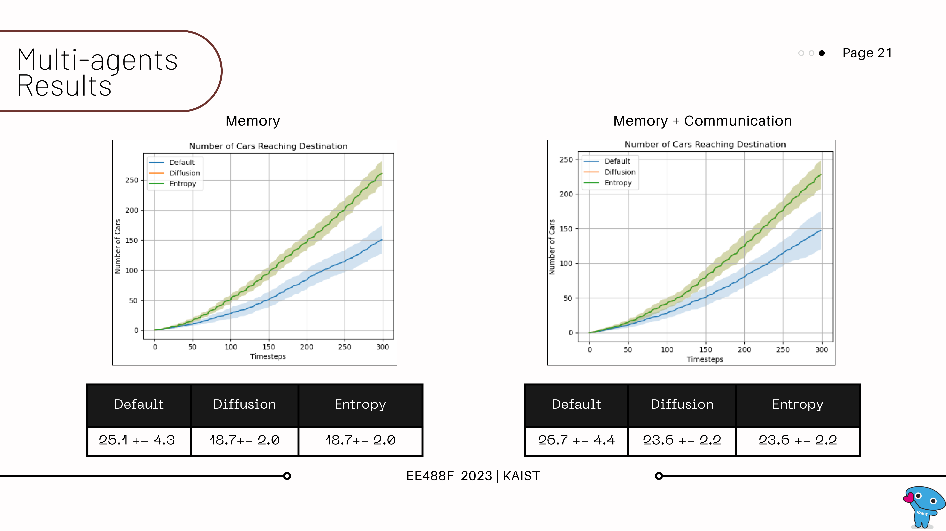

Slide 22
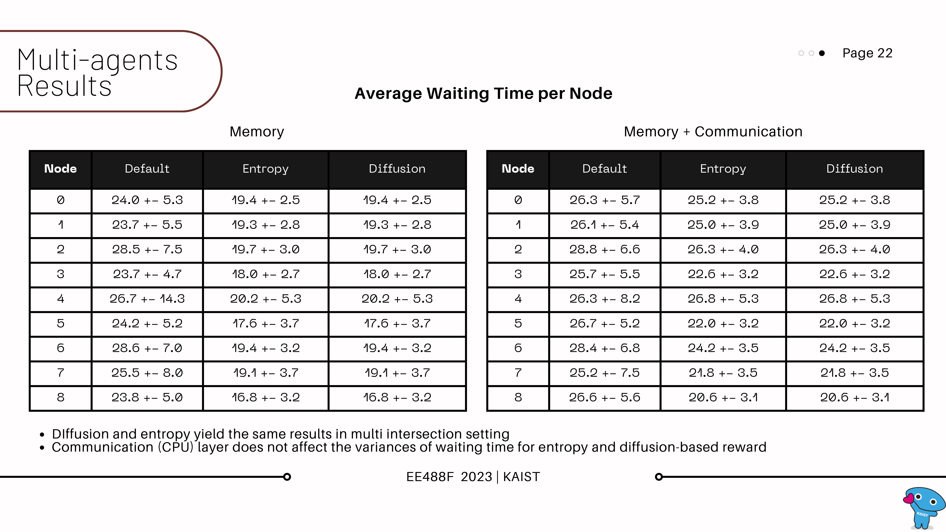

Slide 23
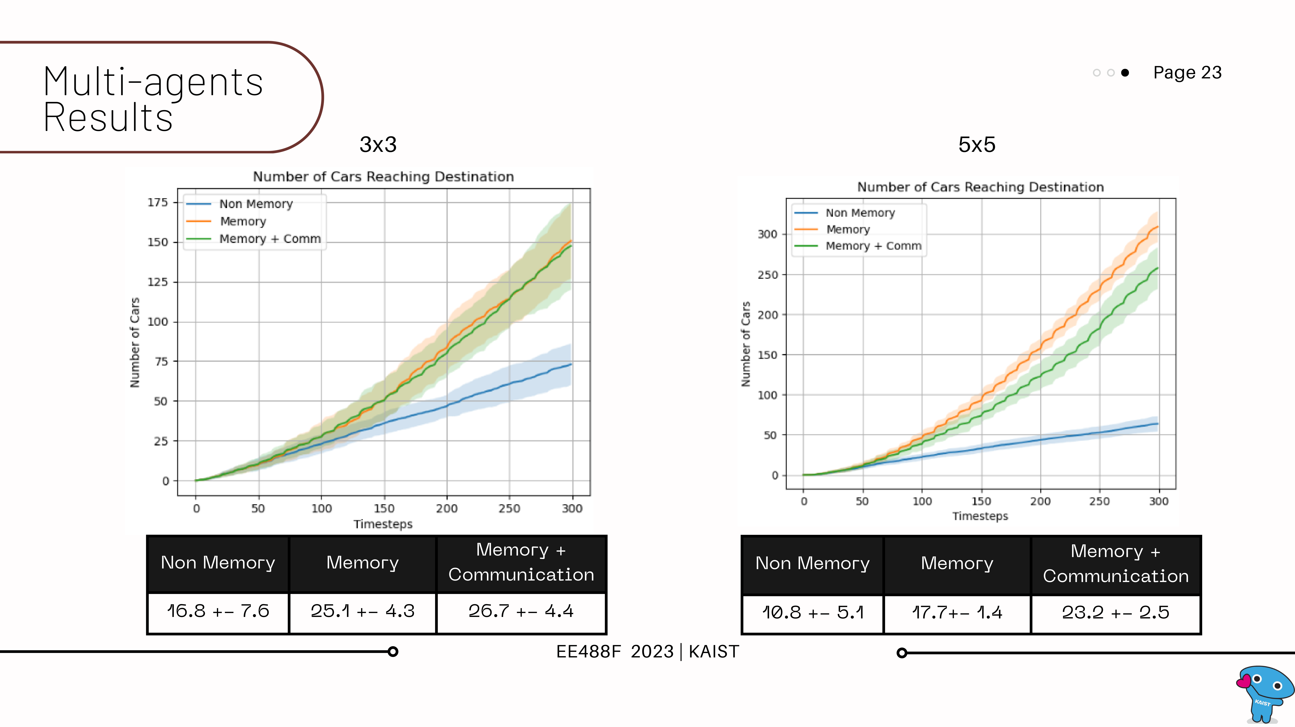

Slide 24
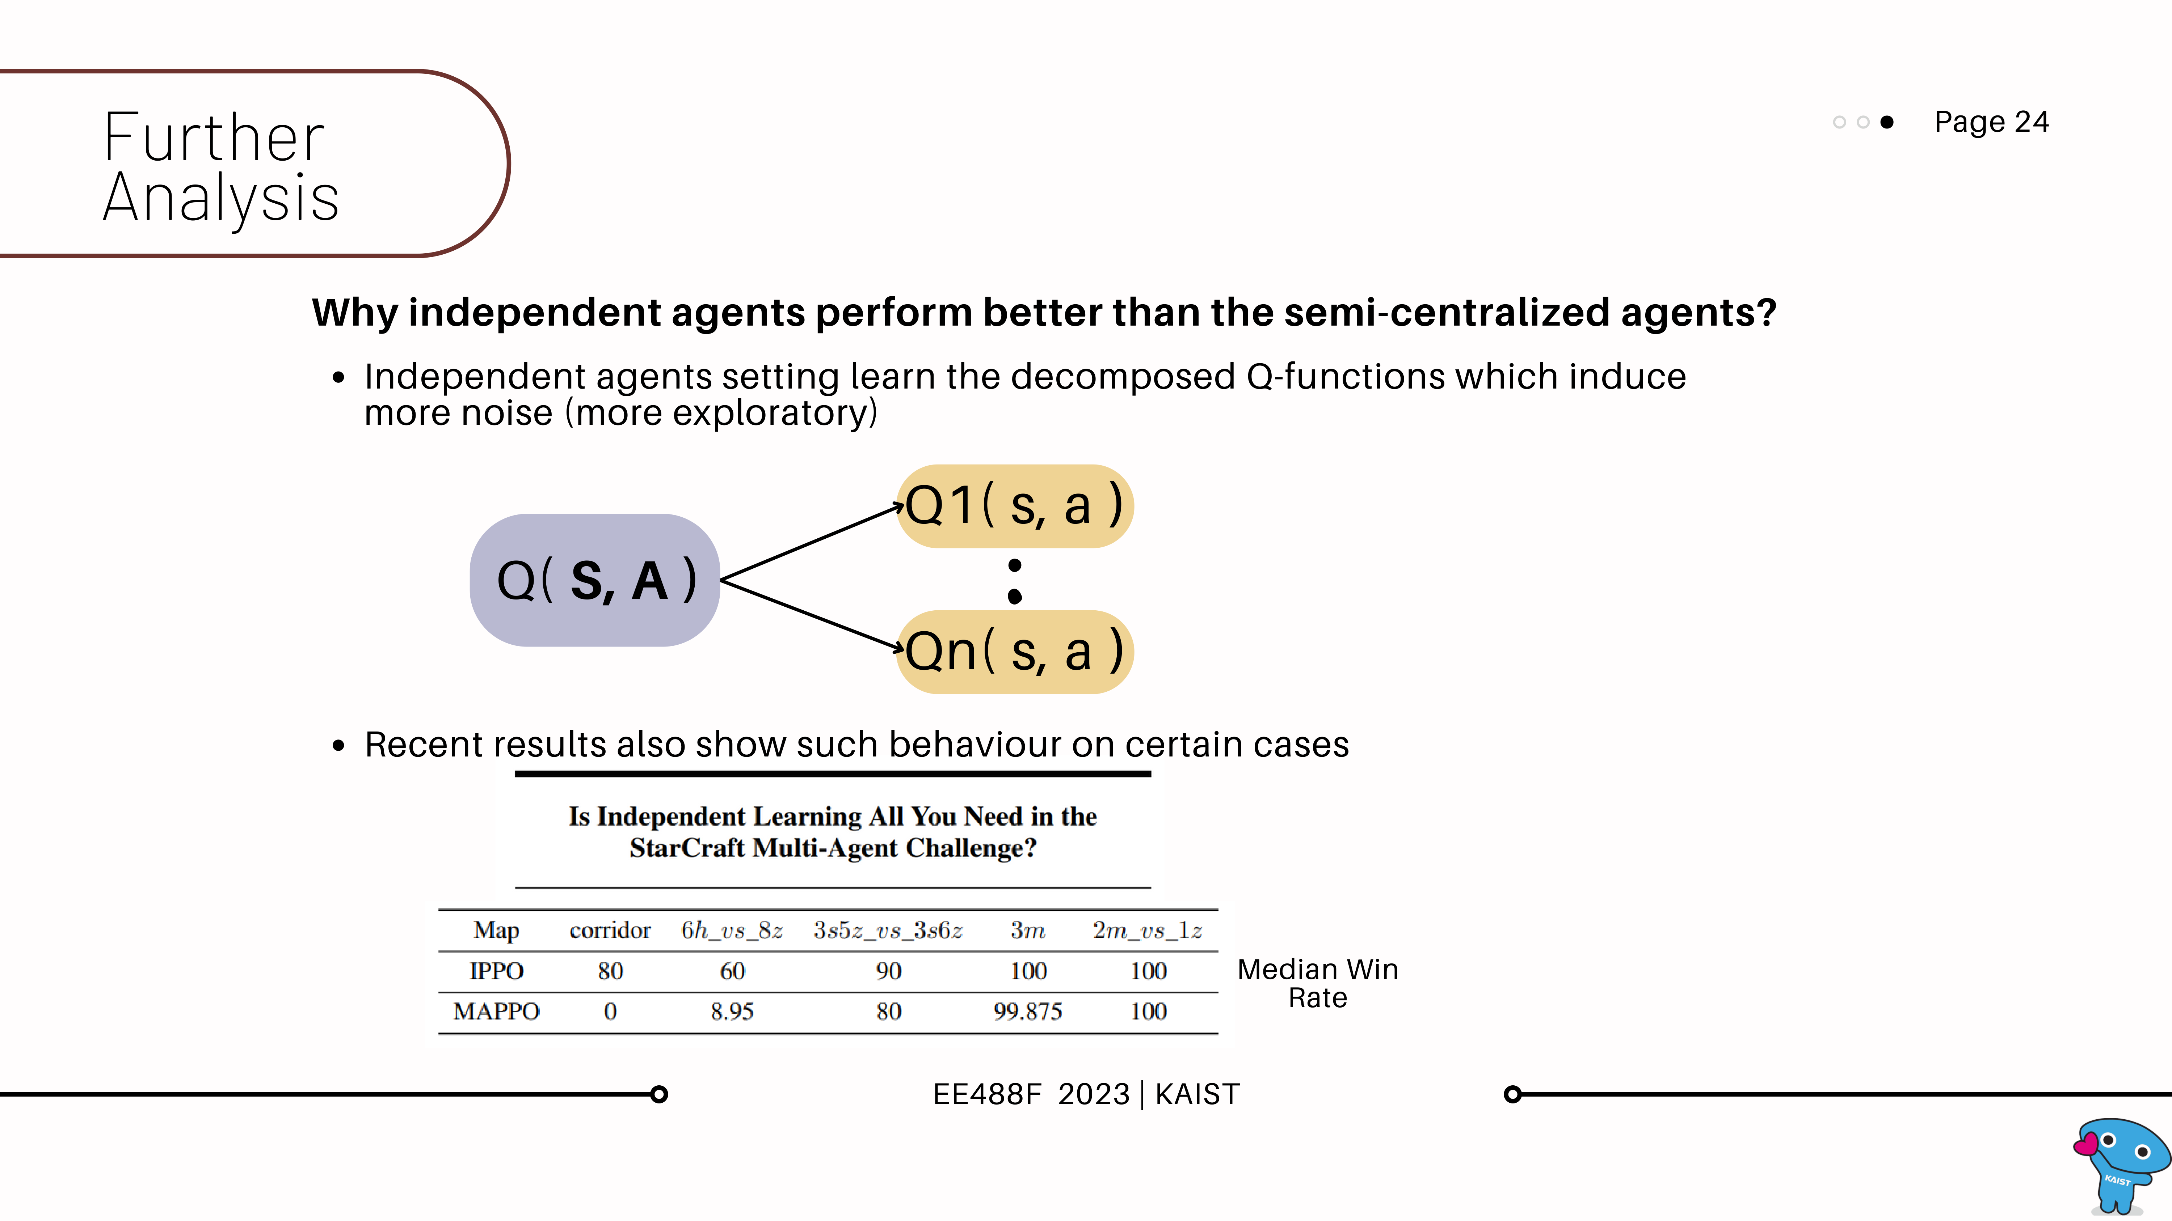

Slide 25
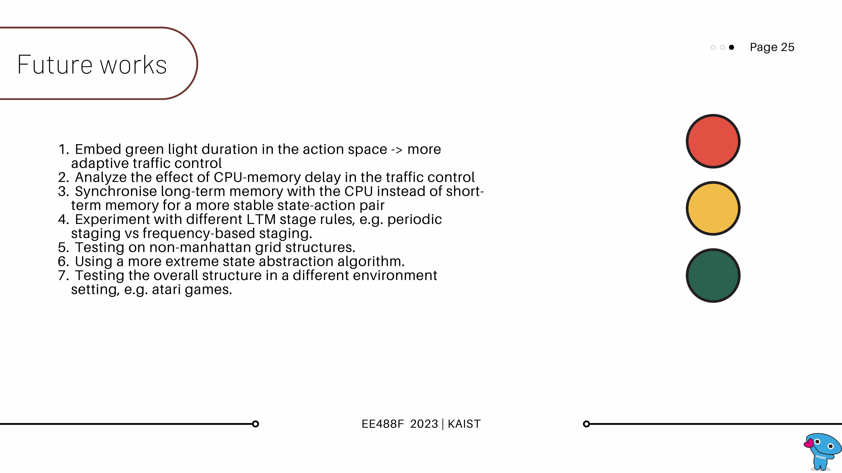

Slide 26
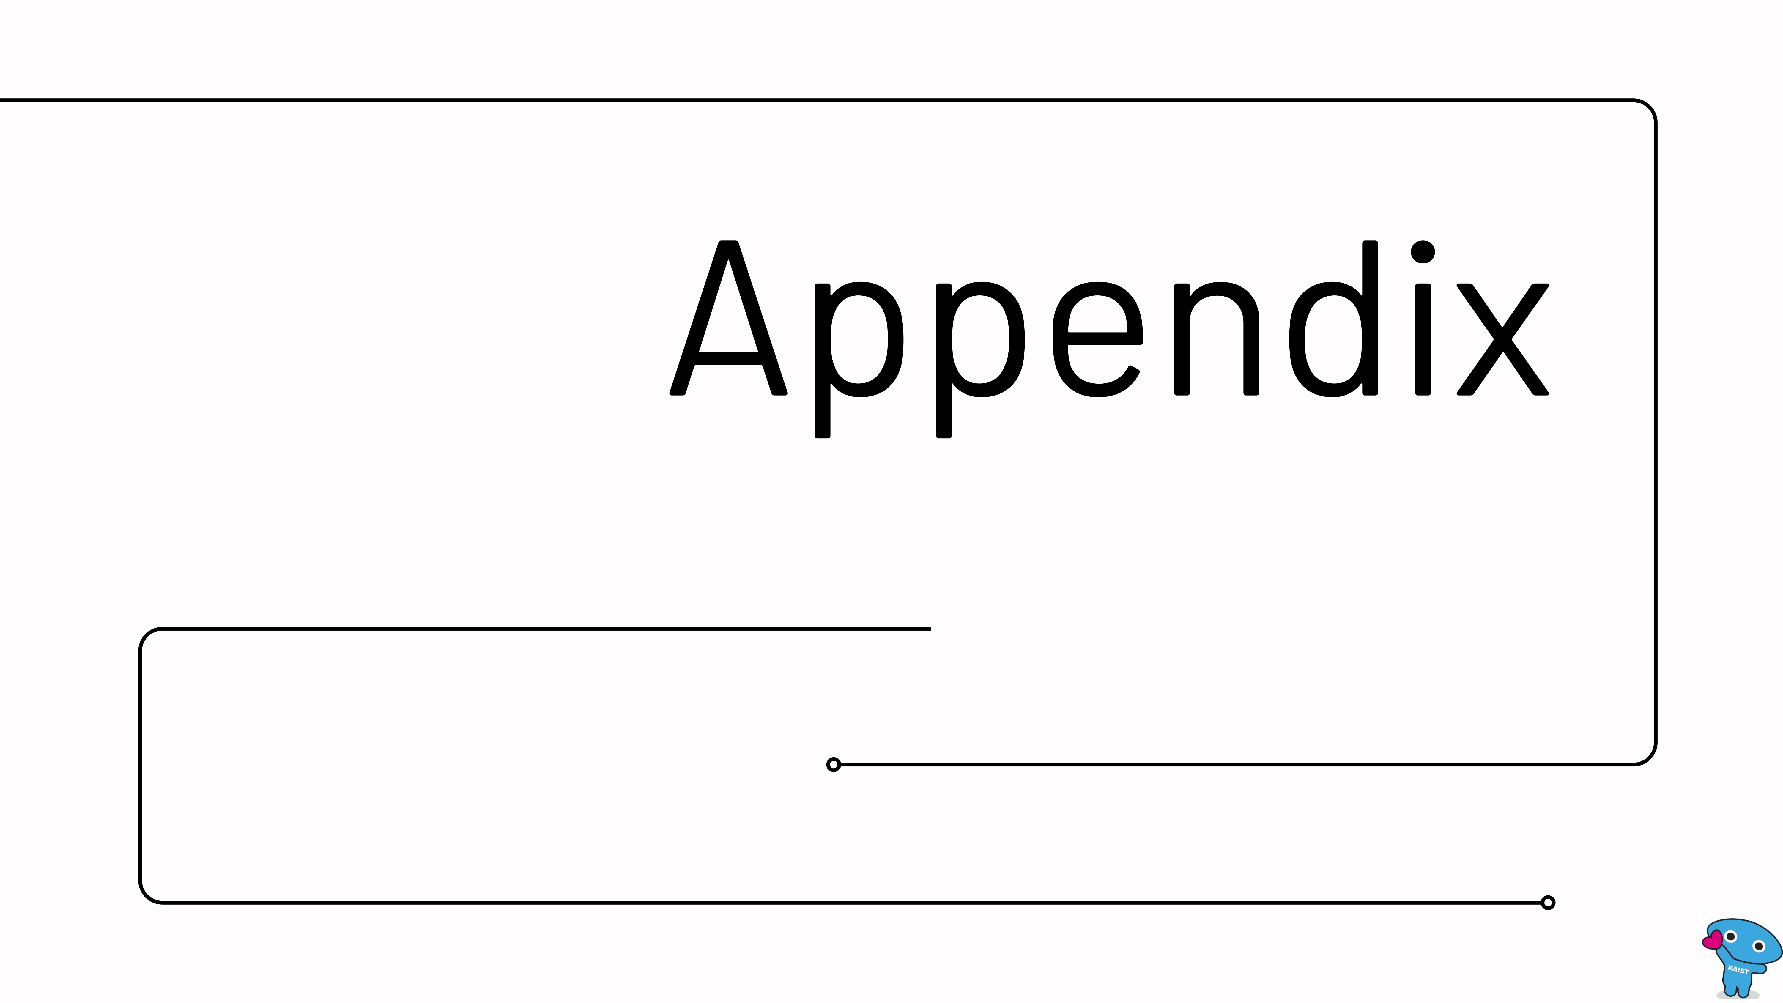

Slide 27
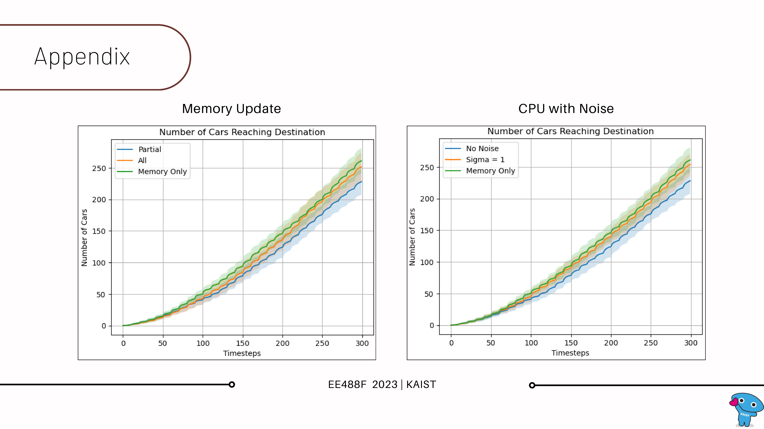

Slide 28
